Slide 1


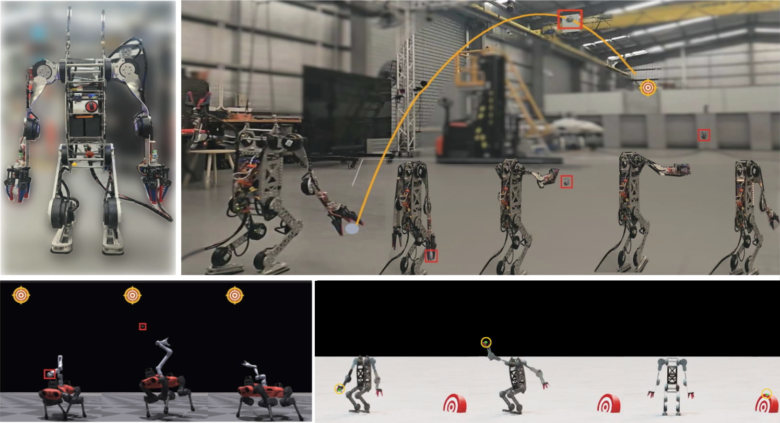
Whole-Body Dynamic Throwing with Legged Manipulators
Humphrey Munn [1,2], Brendan Tidd [2], Peter Bohm [1,2], Marcus Gallagher [1], David Howard [2]
[1] School of Electrical Engineering and Computer Science, The University of Queensland, QLD 4072, Australia
[2] CSIRO Robotics, Data61, CSIRO, Brisbane, Australia
Notes:
Presenting our phd paper titled …
Good morning/afternoon everyone. I'm Humphrey Munn from the University of Queensland and CSIRO Data61. Today I'll be presenting our work on whole-body dynamic throwing with legged manipulators - essentially teaching robots to throw objects accurately using their entire body, not just their arms. This is joint work with Brendan Tidd, Peter Böhm, Marcus Gallagher, and David Howard.

Slide 2
Motivation
Locomotion and manipulation well-studied separately; dynamic integration remains underexplored
Full-body throwing: combines both without complex manipulation
Multi-objective challenge: task performance vs. stability trade-off
Limitations of existing work:
Targets restricted to 2D plane or directly ahead
Constrained solutions (release velocity only)
Arm-only systems - miss body momentum benefits
Notes:
Chose the throwing task for a few reasons.
It is a basic skill that humans use, it can be faster than manually moving an object, or if it is needed in a hard to reach place (Obviously drones are the use case for this, but we dont always want to have specialist robots)
Loco manipulation required for many real world tasks, no obvious decomposition, full
body learning involves high DoF so learning is harder, full body throwing is a good simple step towards this
Stability trade-off
Found a gap in the capability of throwing robots
So why throwing? The field has made tremendous progress on locomotion and manipulation independently, but tasks requiring dynamic integration of both remain challenging. Throwing is an ideal testbed - it requires precise coordination between body movement and object handling, but without the complexity of dexterous manipulation.
It's also a genuinely useful capability - throwing can deliver objects faster than walking, and reach places a robot can't access directly. Think emergency supplies, tools to workers, or safety equipment.
From a research perspective, there's an interesting multi-objective problem here: how do you maximise throwing performance while maintaining stability? Push too hard and the robot falls over.
Looking at prior work, most approaches have significant limitations. They either restrict targets to a 2D plane, solve only for release velocity rather than exploring full motion possibilities, or use arm-mounted systems that can't exploit body momentum. We wanted to address all of these.

Slide 3
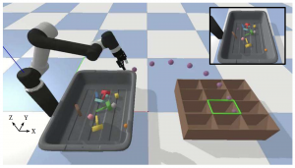
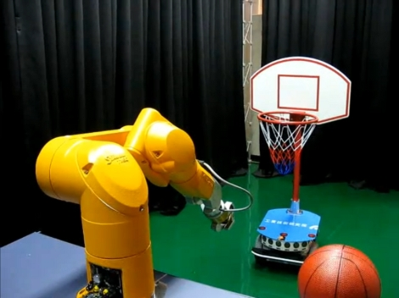
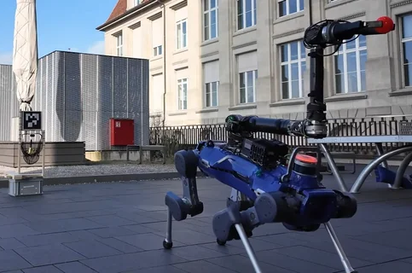
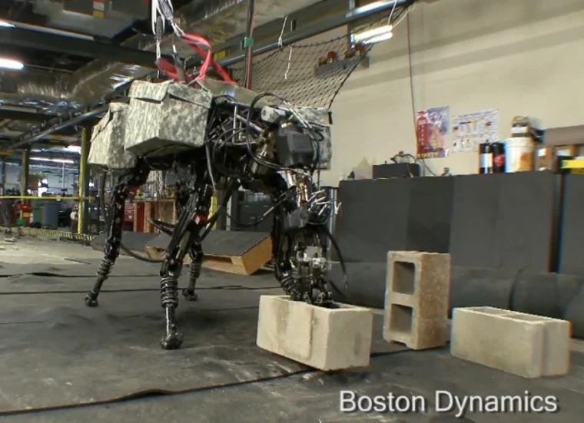
Existing approaches
Release velocity methods: TossingBot [1], basketball throwing
Effective but constrained; no full-body dynamics
Trajectory optimisation: BigDog throwing [3]
Shows full-body benefit, but requires careful modelling; limited generalisation
Recent work: Pull-back tube method [4] (IROS 2025)
Forward throws only; constrained solution
[1] Zeng et al., 2020
[2] Hu et al., 2010
[4] Ma et al., 2025
[3] Abe et al., 2013
Notes:
Here is some other throwing robot papers, im not the first one.
Some great solutions. However, there are 3 main gaps.
They typically only work with an arm as the kinematics are a lot simpler and stable, with a few exceptions, however all throwing papers I have seen heavily constrain the robot behaviour which has some disadvantages
Because of this they aren't able to take advantage of a body that can increase operating range and power e.g. twisting and throwing, or using momentum
The targets are either directly in front of the robot, or sometimes lie on a 2d plane at a fixed height
Let me quickly survey what's been done. Methods like TossingBot solve for the optimal release velocity given a target - effective for bin sorting but doesn't explore alternative throwing strategies. The BigDog cinder block throwing work showed the power of full-body motion through trajectory optimisation, but TO requires careful system modelling and doesn't generalise easily to new targets.
More recent approaches like the pull-back tube method still only throw forward and use constrained solutions. None of these approaches give us what we want: generalised 3D throwing using full-body dynamics with a learning-based approach that can discover novel strategies.

Slide 4
Contributions
Novel 3D throwing formulation with deep RL for legged manipulators
Adaptive curriculum balancing accuracy and stability with auto-tuned thresholds
Comprehensive evaluation on humanoid and quadruped; sim-to-real transfer demonstrated
Notes:
Our contributions are threefold. First, we formulate full-body robotic throwing as a deep RL problem that generalises to arbitrary 3D targets - not just forward or on a plane, but anywhere within the robot's range.
Second, we introduce an adaptive curriculum that balances the competing objectives of throwing accuracy and stability. Critically, we optimise the curriculum thresholds automatically rather than hand-tuning them.
Third, we provide extensive evaluation on two different robot morphologies - an armed quadruped and a humanoid - and demonstrate successful sim-to-real transfer on the humanoid platform.

Slide 5
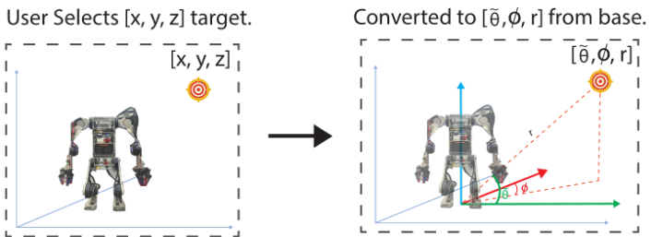
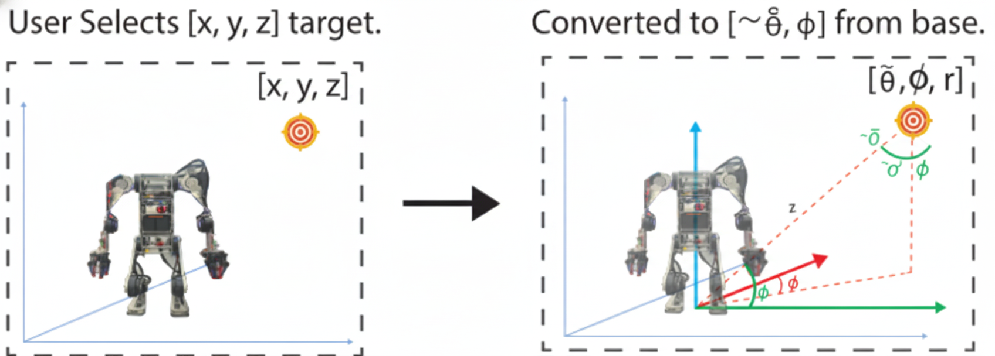
Task definition
Target representation: Spherical coordinates (r, θ, φ)
Covers all 3D locations within radius r
Accuracy metric: Minimum distance between ball trajectory and target
Training: Targets uniformly sampled across full range
Target (x,y,z)
Target (x,y,z)
Error (m) (small)
Error (m) (large)
Notes:
For the task definition, we represent target positions in spherical coordinates - radius r, polar angle theta, and azimuthal angle phi. This parameterisation naturally covers all possible 3D targets within the robot's range.
We measure accuracy as the minimum Euclidean distance between the ball's trajectory and the target position at any point. This means a ball that passes close to the target is rewarded even if it doesn't land exactly there - important for high targets above ground level.
During training, we uniformly sample targets across the full range, so the policy learns to generalise rather than memorising specific throws.

Slide 6
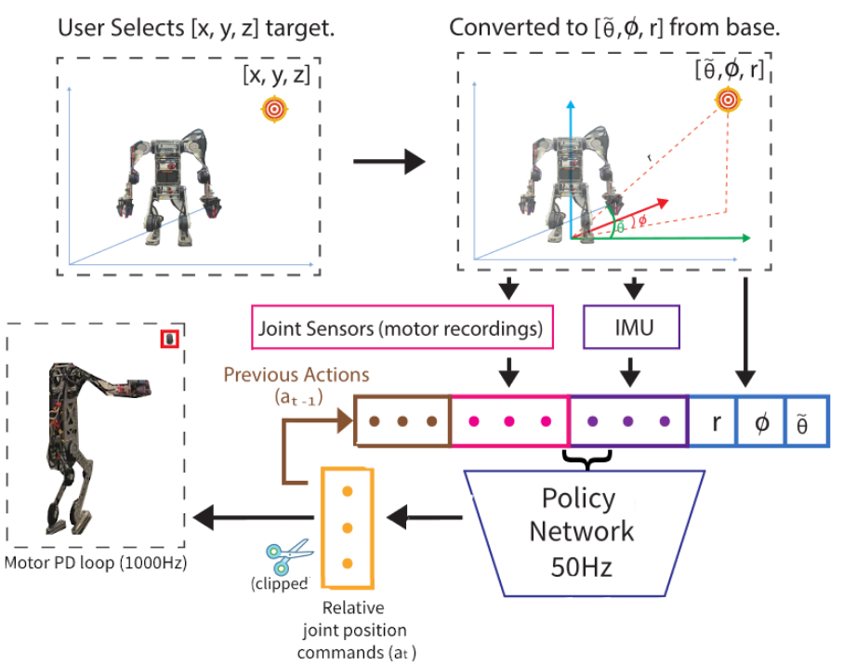
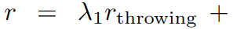
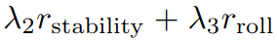
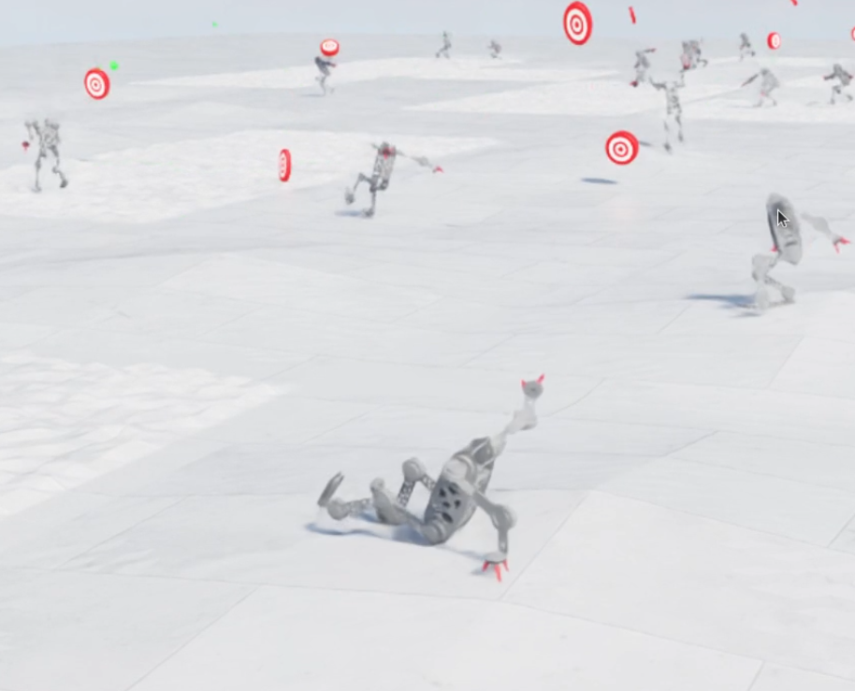
Reinforcement Learning Formulation
Reward: (r_roll: humanoid only)
Throwing: sparse, inverse distance; uses projectile motion estimation
Stability: binary; upright with no collisions
Roll: penalises roll deviation from upright pose -> humanoid has no hips
Observations: IMU velocity, target (r, θ, φ), joint states, previous action, ball status, estimated ball displacement
Actions: Joint position commands at 50Hz via PD control
Training: Distributed PPO in Isaac Lab (4096 parallel envs)
Notes:
For the RL formulation, we have three reward components. The throwing reward is sparse - only given once the ball leaves the hand - and inversely proportional to the distance from target. We use projectile motion to estimate where the ball will land immediately at release, rather than waiting for the full simulation. This significantly reduces the delay between action and reward, which helped learning considerably.
The stability reward is binary - the robot must stay upright without collisions throughout the episode. For the humanoid, we add a roll penalty because it lacks hip abduction and can't recover from significant roll.
Observations include IMU data, the target in spherical coordinates, joint positions and velocities, the previous action, whether the ball has been released, and an estimate of current throwing displacement. This last observation is privileged information we gradually replace with noise during training. Essentially it tells the robot at every time-step what reward it would get if it let go of the ball now.
Actions are joint position commands at 50Hz, implemented through PD control. We train using distributed PPO in Isaac Lab across thousands of parallel environments.

Slide 7
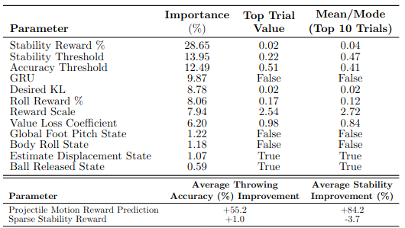
Adaptive Curriculum
Challenge: Stability vs. accuracy trade-off creates local optima
Easy stability → overly conservative throws
Easy throwing → falls over
Solution: Adaptive curriculum with dual thresholds
Start at 1m; increase range when BOTH thresholds met
Lets stability "catch up" to throwing
Key insight: Auto-tune thresholds via Optuna (TPE)
Thresholds highly correlated with final performance
Outperformed all manually-tuned variants
Thresholds were: 22% average stability, 51% normalised average throwing accuracy
Automated ablation of system components via Tree-structured Parzen Estimator asynchronous hyper-parameter optimisation.
Notes:
The curriculum design is crucial. If stability is easy to achieve, the policy becomes overly conservative and won't explore dynamic throwing motions. If throwing is easy, it learns to throw hard but falls over. Both are local optima.
Our solution starts with easy 1-metre throws and only increases difficulty when both a stability threshold AND an accuracy threshold are met. This lets stability catch up - if the robot is throwing well but falling over, difficulty doesn't increase until it learns to stay upright.
The key insight is that we don't manually tune these thresholds. We use Optuna with Tree-Structured Parzen Estimation to optimise them automatically. Our ablation showed these thresholds are highly correlated with final policy performance - more important than most other hyperparameters. The auto-tuned curriculum consistently outperformed our best manual attempts.

Slide 8
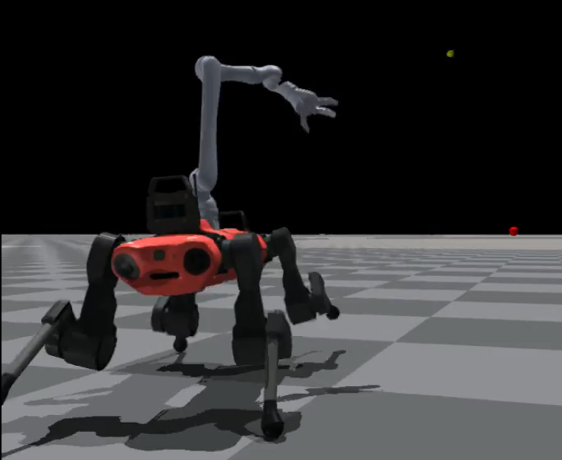
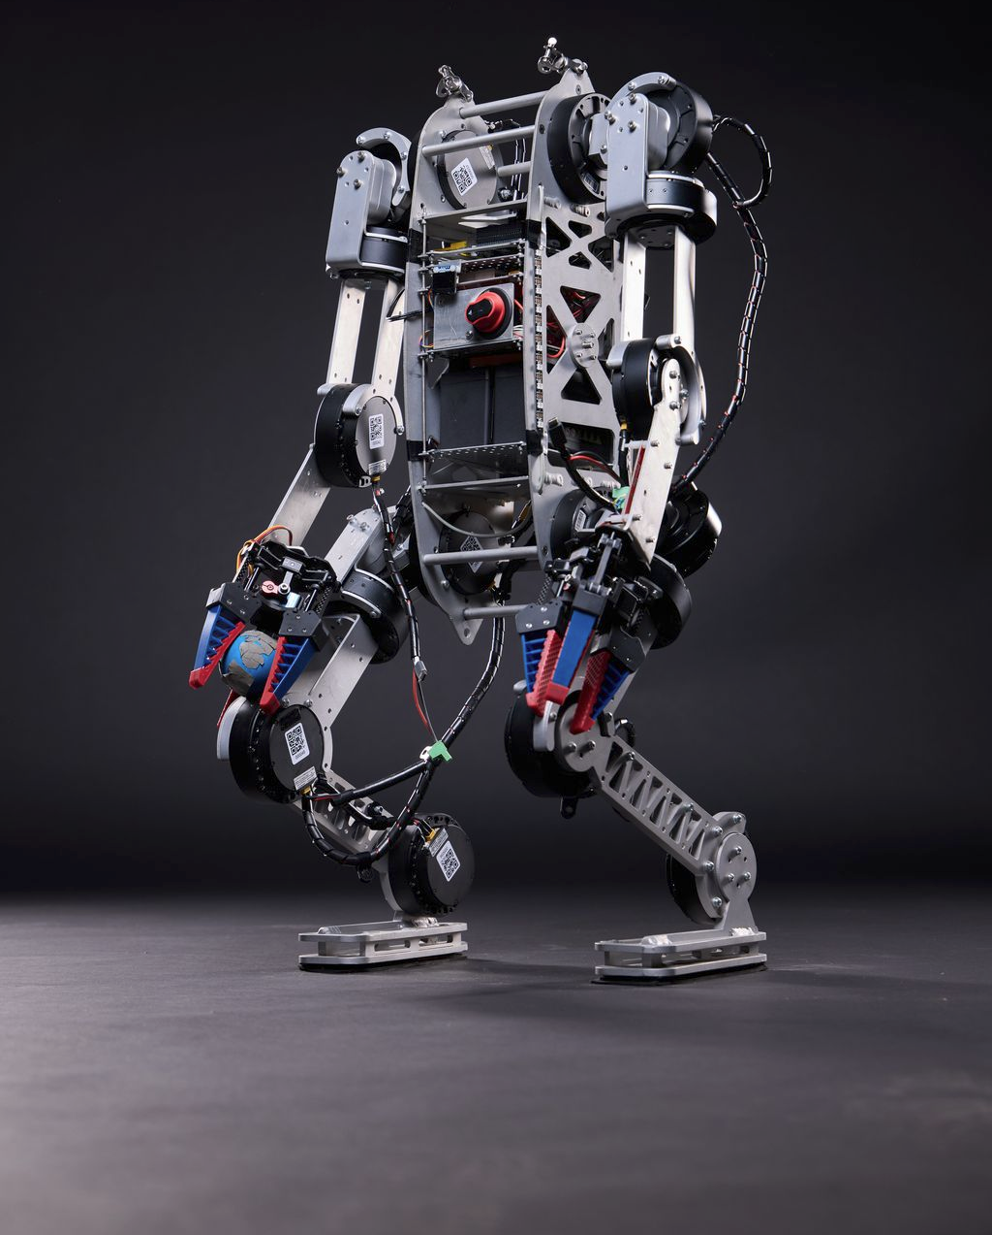
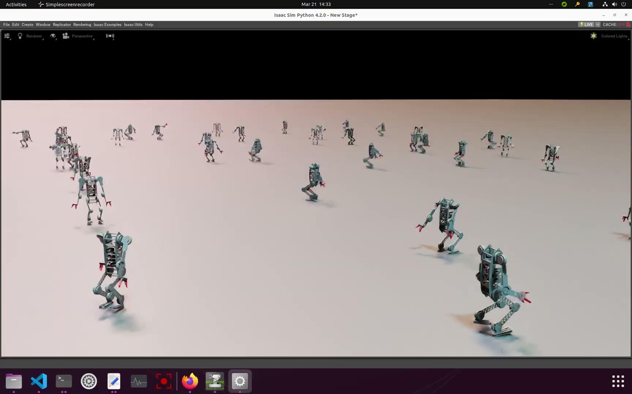
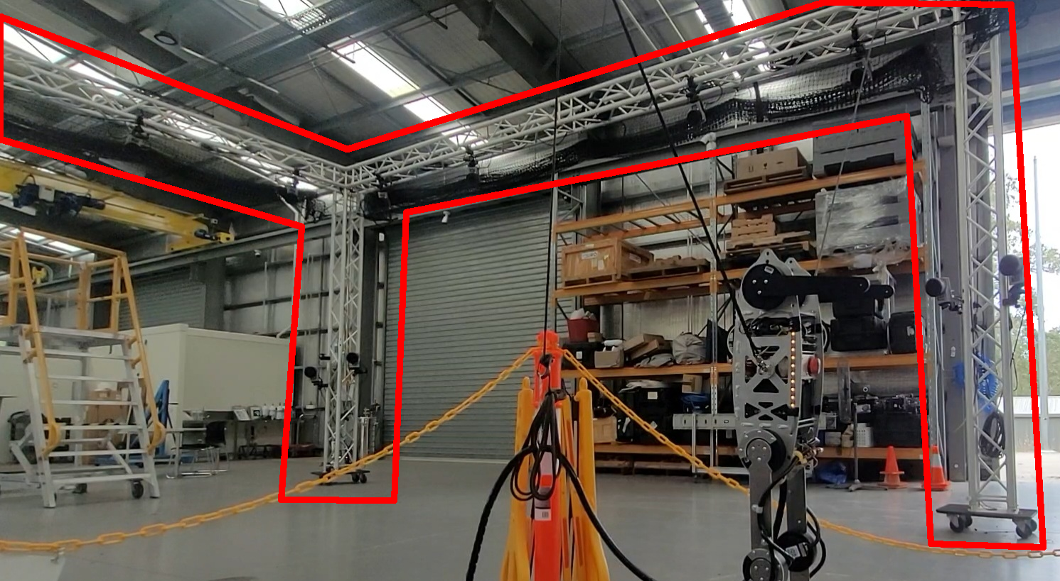
Robots and Experimental Setup
Platforms:
ANYmal C + Kinova arm (19 DoF) - sim only
"Chuck" humanoid (13 DoF) - sim + real
Tasks:
General: arbitrary 3D targets (humanoid: 1-5m distance, quadruped: 3-8m distance)
Distance: maximum range (humanoid: 4-16m, quadruped: 3-35m)
Real-world: Motion capture for ground truth ball tracking
AnymalC with Kinova Arm
“Chuck” - in-house humanoid robot
Notes:
We evaluated on two platforms. The ANYmal C quadruped with a Kinova arm gives us 19 degrees of freedom - a high-DoF system becoming increasingly common. We tested this in simulation only due to hardware access.
Our humanoid "Chuck" is a 13-DoF in-house design with MIT Cheetah-derived actuators. It has less stability than the quadruped but represents the more challenging and increasingly relevant humanoid morphology. We tested Chuck in both simulation and the real world.
We ran two types of experiments. General throwing tests targets anywhere in 3D space to evaluate generalisation. Distance throwing fixes targets straight ahead to test maximum range. The quadruped can throw much further due to its more powerful arm.
For real-world validation, we used motion capture to get ground-truth ball trajectories.

Slide 9
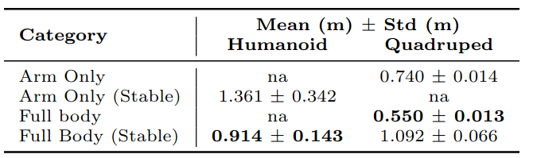
Simulation results - Accuracy and Generalisation
Full-body consistently outperforms arm-only across all distances
Exponential error growth with distance (expected from projectile physics)
Humanoid: Full-body ~0.9m error at 5m vs. ~1.4m arm-only
Quadruped: Full-body superior for >99% of throwing angles
Novel behaviours emerged: counterbalancing, elastic energy storage, foot stepping
Generalist policy throwing accuracy results (5 trials each)
Notes:
Looking at accuracy results, full-body policies consistently outperformed arm-only across both robots and all distances. The error grows exponentially with distance - this is expected from projectile motion physics where small release velocity errors compound over distance.
For the humanoid general task, full-body achieved around 0.9m average error versus 1.4m for arm-only. The quadruped showed full-body superior for over 99% of tested throwing angles when we swept across all combinations of theta and phi. These results include domain randomisation and Gaussian sampling of actions, so are actually an over-estimate of the true error.
What's exciting is the novel behaviours that emerged. The policies learned to counterbalance with the opposite arm, store elastic energy in the body before release, and even step with the feet for stability during aggressive throws - all without being explicitly programmed.

Slide 10
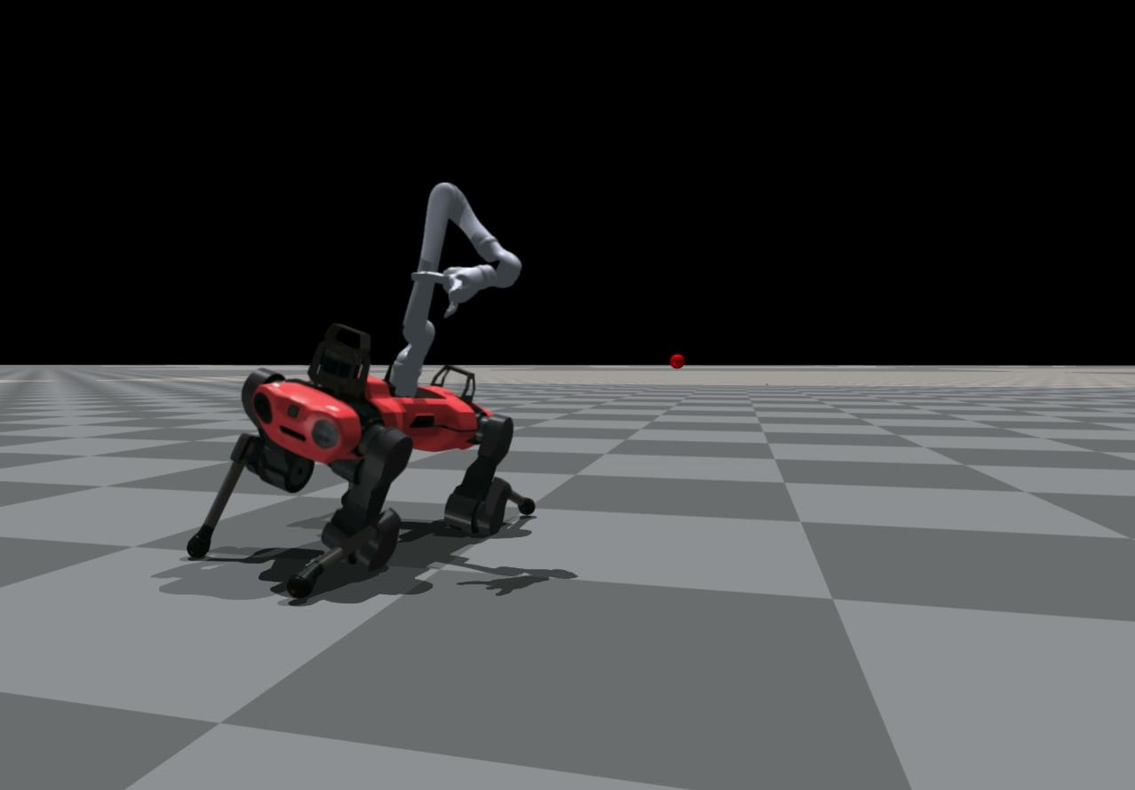
Notes:
Here is an example of a long range throw with the quadruped.

Slide 11
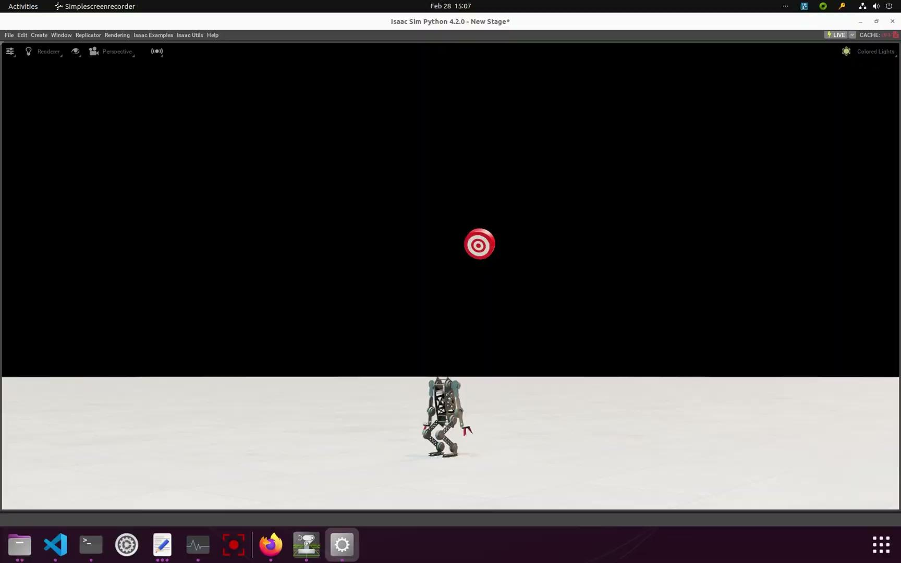
Notes:
This is a video of a learnt policy generalising to throwing at any target near the robot and maintaining stability. As you can see the accuracy is not perfect but considering the small size of the neural network (about 50000 parameters) it is quite good.

Slide 12
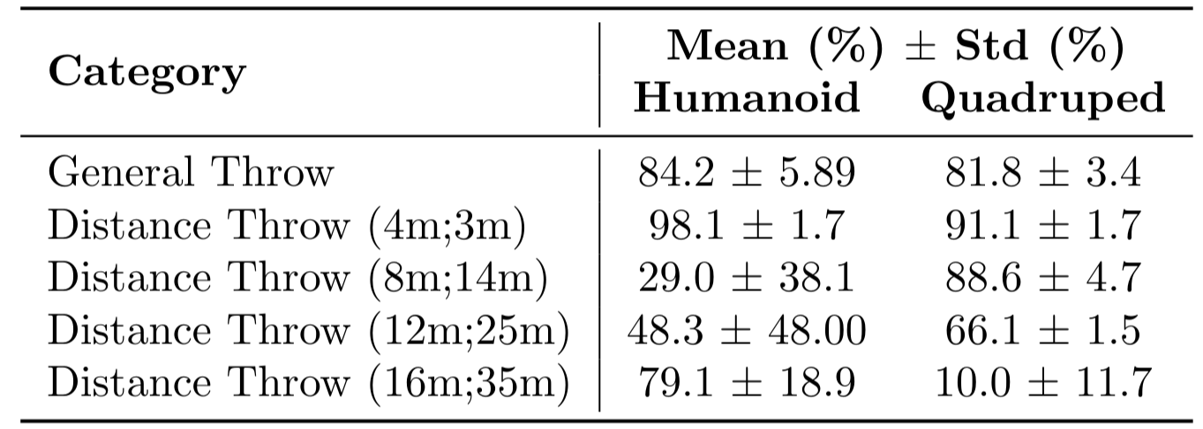
Simulation results - Stability
General throwing: ~84% humanoid, ~82% quadruped stability
Short distance (4m): 98% humanoid, 91% quadruped
Long distance more challenging: stability-accuracy trade-off evident
High variance in humanoid due to learning algorithm sensitivity
Adaptive curriculum essential for achieving both objectives
Notes:
For stability, our general throwing policies achieved around 84% stability for the humanoid and 82% for the quadruped. At short distances like 4 metres, we hit 98% stability for the humanoid.
Longer distances showed more variance - the stability-accuracy trade-off becomes evident when pushing maximum range. The humanoid showed higher variance across seeds, reflecting the learning algorithm's sensitivity to the more constrained morphology.
The key takeaway is that the adaptive curriculum was essential. Without it, policies either learned to stand still or throw themselves over. With it, we could achieve both accurate throws and stable postures.

Slide 13
Real world - Deployment and Results
4m target results: 80cm average error, 6cm best run
Stable throughout all trials (no falls)
Tested with 1.25kg payload - comparable accuracy, remained stable
Long-range (open-loop): 13.8m achieved - 4.95m beyond arm-only max
Challenges: sensor misalignment, faulty motors limited some throws
Notes:
For real-world deployment, we transferred our policies to the Chuck humanoid. At a 4-metre target, we achieved 80cm average error with our best run hitting just 6cm from target. Importantly, the robot remained stable throughout all trials.
We also tested with a 1.25kg payload to simulate different objects - accuracy was comparable and stability maintained.
For maximum range, we deployed a long-distance policy in open-loop and achieved 13.8 metres - that's nearly 5 metres further than the maximum stable arm-only throw.
We did encounter challenges. Sensor misalignment during rapid movements and some faulty motors limited the most aggressive policies. Open loop policies still worked fairly well. The gap between simulation and reality is an area for future work. I have recently tested this on our new unitree humanoid robot which worked quite successfully.

Slide 14

Notes:
Here are the videos.
This (may) be the furthest a legged humanoid has thrown… but ?

Slide 15
Limitations
Accuracy at human-level but errors of ~10s of cm remain
Sim-to-real gap on humanoid; Unitree G1 showed smaller gap
Training sensitive to reward coefficients and random seeds
Sample efficiency could improve; exploration remains challenging
Tested on single ball type; object variation not addressed
Notes:
Let me be upfront about limitations. Our accuracy is roughly human-level, but errors of tens of centimetres would be limiting for precision applications.
The sim-to-real gap was noticeable on our humanoid, though initial tests on a Unitree G1 showed a smaller gap - suggesting hardware quality matters significantly. The engineering time it took to get this to work on the original platform was significant, but with a unitree it was a matter of 2 or 3 days.
Training is sensitive to reward coefficients and random seeds. We mitigated this with automatic tuning, but variance across runs remains. Sample efficiency in massively parallel PPO could be improved - we're likely not finding the global optimum.
Finally, we only tested with a single ball type. Generalisation to different object shapes, masses, and inertias is clear future work.

Slide 16
Future work
Better exploration methods for RL
Extension to other dynamic motor skills
More complex manipulation (varying objects, catching)
Pursuing superhuman accuracy (theoretically achievable)
Generalisation: terrain variation, different objects
Notes:
For future work, better exploration in RL could help find more optimal policies. The throwing task is inherently sparse and delayed, making exploration difficult.
We'd like to extend to other dynamic motor skills - jumping, kicking, catching. More complex manipulation with varying objects is a natural next step.
Interestingly, superhuman accuracy should be theoretically achievable - robots don't have the neural noise humans do. But we're not there yet, which suggests room for algorithmic improvement.
Finally, generalisation to uneven terrain and different object properties would make this more practically useful.

Slide 17

Thank you
Q&A Welcome!
Notes:
Thanks…

